Slide 1
🟧 Sales Performance
📊 Revenue Trends Analyze monthly and yearly sales trends to understand business growth.
🏆 Top-Selling Products Identify best-performing products and product lines by revenue.
💰 Payment Analysis Evaluate customer payments to assess cash flow patterns.
🟧 Geographic & Business Insights
🌍 Regional Performance Analyze sales performance across countries and cities.
📈 Key Insights & Recommendations Provide actionable insights for sales improvement, inventory optimization, and targeted marketing.
Retail Business Analysis
🟧 Customer Analysis
👥 Customer Demographics Analyze customer distribution by region and country.
🌟 Top Customers Identify high-value customers contributing maximum sales.
💳 Credit Behavior Analyze the relationship between credit limits and sales.
🟧 Product & Inventory Analysis
🧩 Product Line Performance Analyze sales contribution of different product categories.
📦 Inventory Movement Identify fast-moving and slow-moving products based on stock and sales.
💲 Pricing Insights Compare buy price and MSRP to evaluate pricing effectiveness.

Slide 2
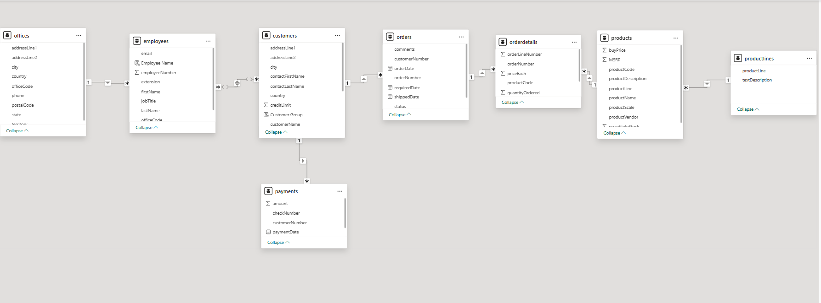
Data Modeling of Retail Business Analysis

Slide 3
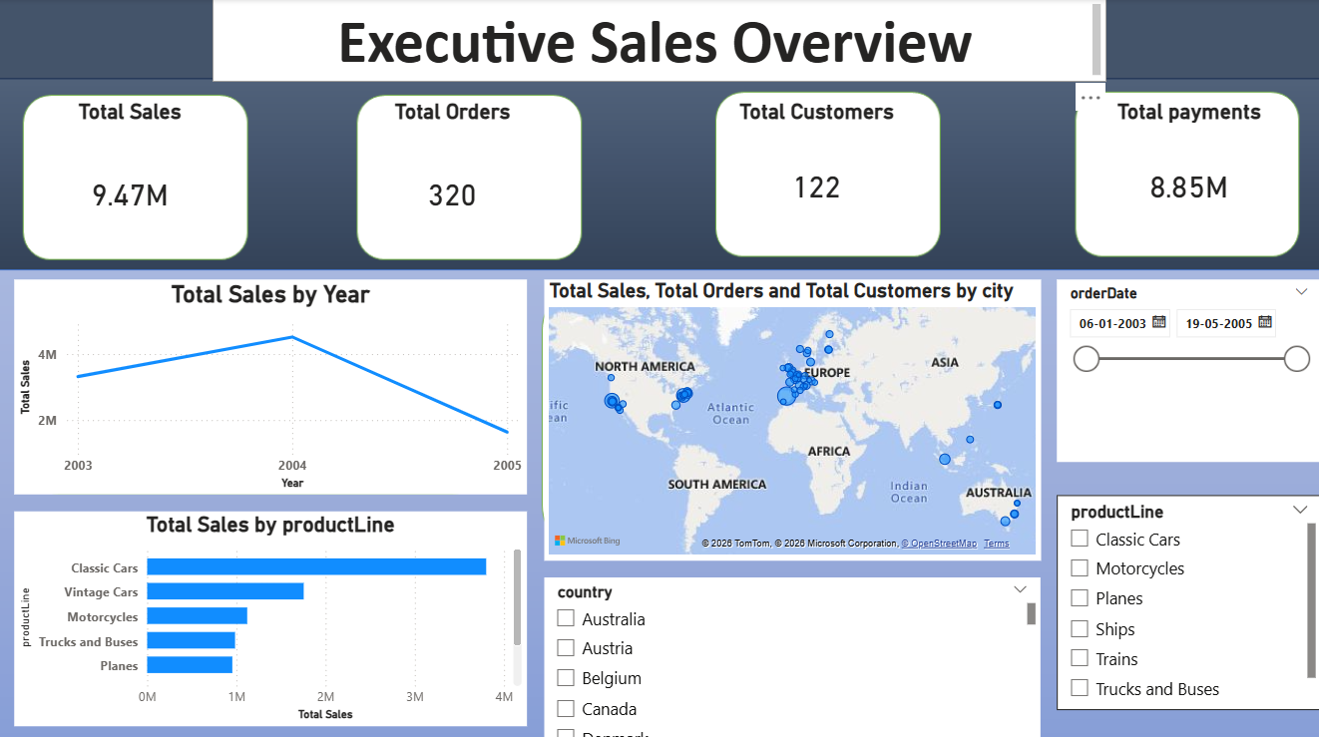

Slide 4
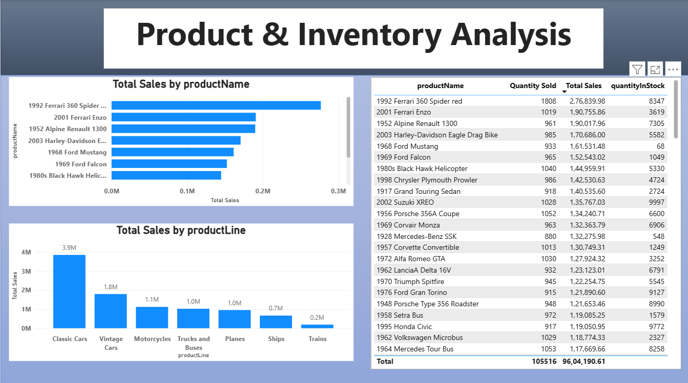

Slide 5
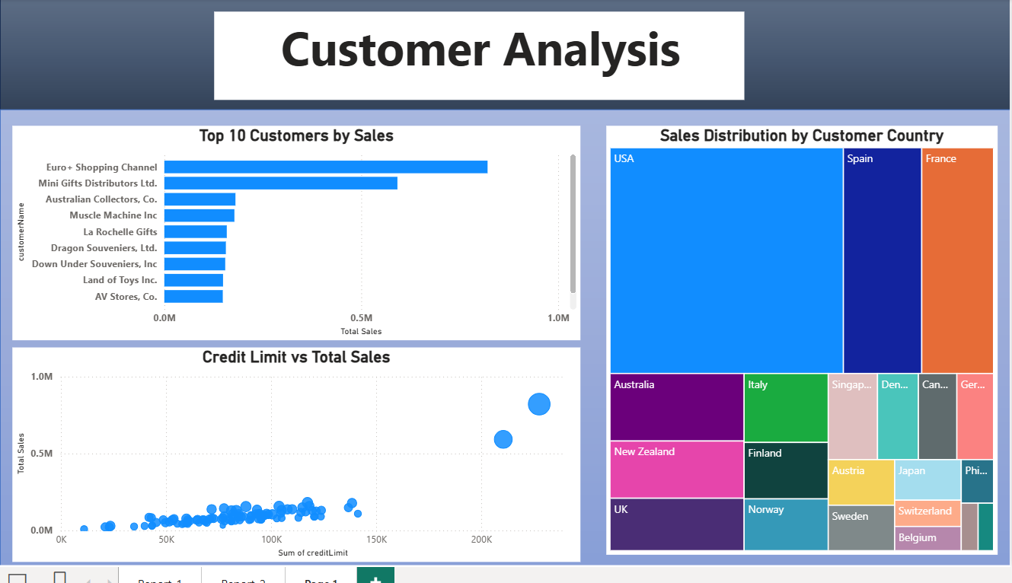

Slide 6
